Slide 1
Basic OOP Concepts and Terms

Slide 2
We will cover:
Objects and examples of different object types
Classes and how they relate to objects
Object attributes and methods
Object interactions and messages
Encapsulation and information hiding
Inheritence and polymorphism
The three-tier architecture design
An introduction to UML

Slide 3
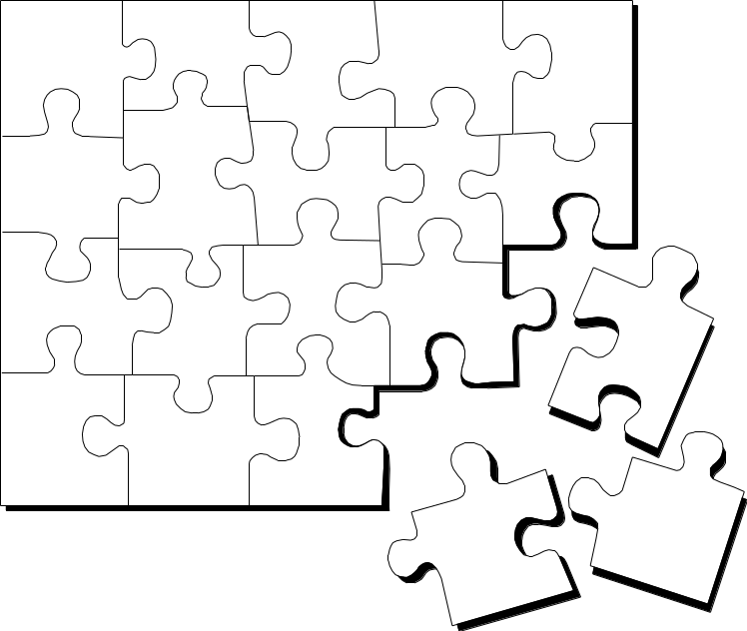
What Is Object Technology?
A set of principles (abstraction, encapsulation, polymorphism) guiding software construction, together with languages, databases, and other tools that support those principles.
Notes:
Object technology is used for creating models that reflect a specific domain using the terminology of the domain.
Models created using object technology should be easy to create, change, expand, validate, and verify.
Systems built using object technology are flexible to change, have well-defined architectures, and have the opportunity to create and implement reusable components.
Models created using object technology are conveniently implemented in software using object-oriented programming languages.
Object technology is not just a theory, but a well-proven technology used in a large number of projects and for building many types of systems.
Successful implementation of object technology requires a method that integrates a development process and a modeling language with suitable construction techniques and tools. (UML Toolkit, Eriksson and Penker, 1997.)
Provide a high-level definition of object technology. Keep in mind that this is all new to most of your students.
Share with the students your excitement about OO. Object technology is not simply the use of an object-oriented language like Java or C++. It is based on the principles of abstraction, modularity, hierarchy, and encapsulation.
If an organization is to successfully implement object technology, they must use more than a language. They must also use process, a modeling language (UML), data modeling techniques, and so on.

Slide 4
The Strengths of Object Technology
Reflects a single paradigm
Facilitates architectural and code reuse
Reflects real world models more closely
Encourages stability
Is adaptive to change
Notes:
So what’s the big deal about object technology? Why has the software industry made such a noticeable shift to object-oriented languages like Java? Much of the answer has to do with the strengths of object technology. There are some people who believe that object technology is a passing fad and will quickly go away, while others believe that object technology is the silver bullet that answers all software development problems. The truth is that the answer probably lies somewhere in between. Object technology is a powerful and challenging way to develop software. The result of this hard work can be a software system that:
Reflects a single paradigm. It provides a consistent language that can be applied for both system and business engineering.
Facilitates architectural and code reuse by clearly articulating the major components and the critical interfaces between them.
Reflects real world models more closely. The objects themselves often correspond to phenomena in the real world that the system is to handle.
Is more stable, a change to the system can be localized to a small part of the system.
Is adaptive to change -a small change in requirements does not mean massive changes to the system.
Emphasize the importance of object technology.
Object technology is NOT easy. It is a highly disciplined way of approaching a software problem. However, the approach can reap benefits over other ways of approaching software development.

Slide 5
The History of Object Technology
Major object technology milestones
Simula
C ++
The UML
1967
Late 1980s
1996
1972
1991
2004
Smalltalk
Java
UML 2
Notes:
Object technology is not a new idea. It has been around for over 30
years. Below is a brief history of the major milestones in the history of object technology.
In 1967, Simula was designed and became the first language to use objects and classes.
In 1972, Alan Kay and others at Xerox PARC created Smalltalk whose roots were tied to Simula. In 1980, Smalltalk became the first commercial release of an object-oriented programming environment.
Bjarne Stroustrop, the originator of the C language, released C++ to the public in the late 1980’s. C++ was not an entirely new language, but an extension of C abilities.
In 1991, James Gosling created a language named Oak that was the predecessor to Java. It was created because his development team at Sun Microsystems was writing software for information appliances. He found that C++ was too complex and insecure for the job. Therefore, he created the Oak language.
UML 2.0 replaces UML version 1.4. Released in 2004, the Object Management Group (OMG) developed two complementary specifications called the Infrastructure and Superstructure specification. The Infrastructure defines the foundational language constructs required for UML 2.0 and serves as an architectural foundation. The Superstructure defines the user level constructs. Together, they constitute a complete specification for the UML 2.0 modeling language.
Review these milestones with the students so that they garner a perspective on object technology’s history.
This slide was included to show students that object technology is not new. It has been around for a long time and is a proven and fairly mature technology.

Slide 6
Most important in OOP
Classes: Blueprints for objects.
Class Instantiation (Object): Making a thing out of a blueprint.
Inheritance: Subclasses of classes “inherit” the superclass properties but can specialize further.
  In procedural programming, you cannot do inheritance. Instead, you must do copy and paste for similar script.
Abstraction: Reduce a given object to its bare essentials, what are the most important attributes of a given object?
Encapsulation: Data is contained in objects, therefore, objects can be treated like black boxes, stuff goes in, stuff comes out, not necessary to show how it’s being treated in the object. Leads to more flexible “modular” design

Slide 7
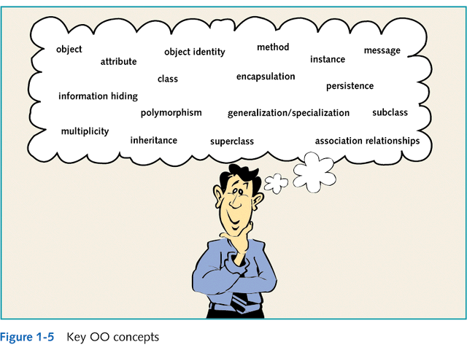

Slide 8
OO Program
An OO program is made of objects, with certain properties and operations that the objects can perform.
In OOP, you only care about what the objects expose, not how it is implemented (inside an object)
Traditional structured programming consists of designing a set of functions (or algorithms) to solve a problem
The key in OOP is to make each object responsible for carrying out a set of related tasks.
  If an object relies on a task that isn't its responsibility, it needs to have access to another object whose responsibilities include that task.
  The object asks another object to carry out the task via method call

Slide 9

Where Are We?
What is an object?
Four principles of OO
What is a class?
Polymorphism and generalization
Organizing model elements
Notes:
Introduce the first topic in this module.

Slide 10

What Is an Object?
Informally, an object represents an entity, either physical, conceptual, or software.
  Physical entity
  Conceptual entity
  Software entity
Truck
Chemical Process
Linked List
Notes:
Objects allow the software developer to represent real-world concepts in their software design. These real-world concepts can represent a physical entity such as a person, truck, or space shuttle.
Objects can be concepts like a chemical process or algorithms.
Object can even represent software entities like a linked list.
Stress that objects can represent anything. Remember, most of your students do not know what an object is.

Slide 11
Examples of Different Object Types
GUI objects
  objects that make up the user interface
  e.g. buttons, labels, windows, etc.
Problem Domain objects
  Objects that represent a business application
  A problem domain is the scope of what the system to be built will solve. It is the business application.
    e.g. An order-entry system
    A payroll system
    A student system

Slide 12

A More Formal Definition
Attributes
An object is an entity with a well-defined boundary and identity that encapsulates state and behavior.
  State is represented by attributes and relationships.
  Behavior is represented by operations, methods, and state machines.
Object
Operations
Notes:
An object is an entity that has a well-defined boundary. That is, the purpose of the object should be clear.
An object has two key components: attributes and operations.
Attributes and relationships represent an object’s state. Operations represent the behavior of the object.
Object behavior and state are discussed in the next few slides.
Emphasize that state, identity and behavior are the key characteristics of an object.
Take a moment to explain the graphic on this slide.
Attributes are documented on the inside of the doughnut.
Operations are documented on the borders, which become clearer to the student as you discuss topics like encapsulation.
Note that the doughnut is not part of the UML notation. UML notation is discussed later.

Slide 13
Three characteristics of objects
Behavior
  The set of methods an object supports.
State
  Determines object’s behavior when methods are invoked.
  E.g., a Robot object's direction after a turnLeft(90) method call depends on its initial heading.
  Represented by an object's fields.
Identity
  Two objects with identical state may not be identical.

Slide 14
An Object Has State
State is a condition or situation during the life of an object, which satisfies some condition, performs some activity, or waits for some event.
The state of an object normally changes over time.
Name: M Zheng
Employee ID: 567138
HireDate: 07/25/2003
Status: Tenured
Discipline: IT
MaxLoad: 3
Name: Michael Zheng
Employee ID: 567138
Date Hired: July 25, 2003
Status: Tenured
Discipline: IT
Maximum Course Load: 3 classes
Professor Clark
Notes:
The state of an object is one of the possible conditions in which an object may exist. State normally changes over time.
The state of an object is usually implemented by a set of properties called attributes, along with the values of the properties and the links the object may have with other objects.
State is not defined by a “state” attribute or set of attributes. Instead, state is defined by the total of an object’s attributes and links. For example, if Professor Clark’s status changed from Tenured to Retired, the state of the Professor Clark object would change.
Explain the concept of state to the students.
Provide some supplemental state exercises to ensure that the class understands the concept of state. For example an online order (Pending, Approved, Shipped, BackOrdered, Cancelled, etc.) or a car’s Cruise Control (Engaged, Disengaged, On, Accelerating, Decelerating).

Slide 15
An Object Has Behavior
Behavior determines how an object acts and reacts.
The visible behavior of an object is modeled by a set of messages it can respond to (operations that the object can perform).
AcceptCourseOffering()
SubmitFinalGrades()
SetMaxLoad()
Professor Zheng’s behavior
  Submit Final Grades
  Accept Course Offering
  Take Sabbatical
Set Max Load
TakeSabbatical()
Professor Clark
Notes:
The second characteristic of an object is that it has behavior. Objects are intended to mirror the concepts that they are modeled after, including behavior.
Behavior determines how an object acts and reacts to requests from other objects.
Object behavior is represented by the operations that the object can perform. For example, Professor Clark can choose to take a sabbatical once every five years. The Professor Clark object represents this behavior through the TakeSabbatical() operation.
Explain the concept of behavior to the students.
Objects “do” some interesting things. This is where the work in an OO system is done.
The melding of data and behavior is what makes OO such a powerful development technique.

Slide 16


An Object Has Identity
Each object has a unique identity, even if the state is identical to that of another object.
Professor “M Zheng” teaches Java
Professor “J Zhang” teaches Database
Notes:
In the real world, two people can share the same characteristics: name, birth date, job description. Yet, there is no doubt that they are two individuals with a unique identity.
The same concept holds true for objects. Although two objects may share the same state (attributes and relationships), they are separate, independent objects with their own unique identity.
Explain the concept of identity to the students.
Every object is unique, even if it shares the exact same characteristics of another object.

Slide 17
Object Attributes and Methods
Classes contain two things:
  Fields (attributes, data members, class variables):
    Data items that differentiate one object of the class from another. e.g. employee name, student number
    Characteristics of an object that have values
    What are some possible attributes for the customer object?
  Methods (behaviors):
    Named, self-contained blocks of code that typically operate on the fields
    Describe what an object can do
    Can be thought of as the verbs in a problem domain
    What are some possible methods for the customer object?

Slide 18
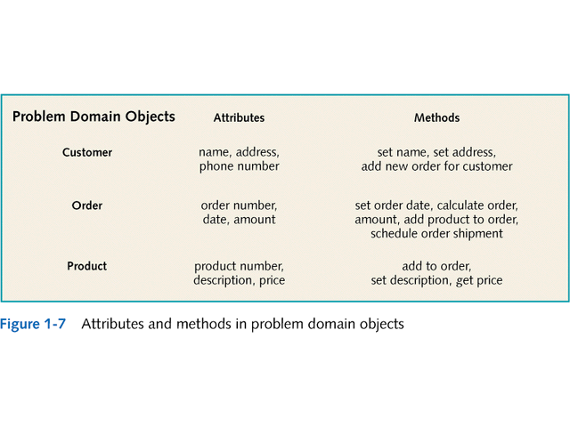

Slide 19
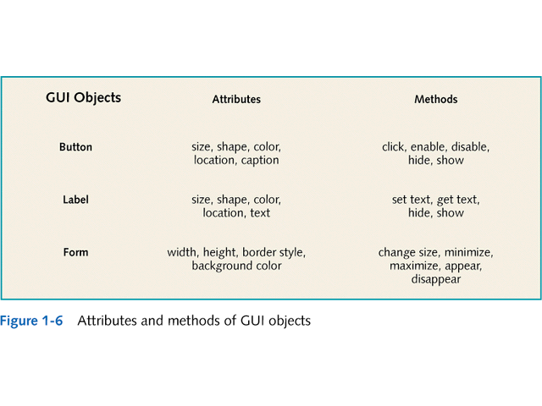

Slide 20
Where Are We?
What is an object?
Four principles of OO
What is a class?
Polymorphism and generalization
Organizing model elements

Slide 21
Basic Principles of Object Orientation
Object Orientation
Abstraction
Encapsulation
Modularity
Hierarchy
Notes:
There are four basic principles of object orientation:
Abstraction
Encapsulation
Modularity
Hierarchy
Introduce the four basic principles of OO.
Be sure the students understand objects before you begin this next section.
You’ve introduced objects first to help students better apply each of these principles.

Slide 22
What Is Abstraction?
  The essential characteristics of an entity that distinguishes it from all other kinds of entities.
  Defines a boundary relative to the perspective of the viewer.
  Is not a concrete manifestation, denotes the ideal essence of something.
Notes:
Abstraction can be defined as:
Any model that includes the most important, essential, or distinguishing aspects of something while suppressing or ignoring less important, immaterial, or diversionary details. The result of removing distinctions so as to emphasize commonalties. (Dictionary of Object Technology, Firesmith, Eykholt, 1995.)
Abstraction allows us to manage complexity by concentrating on the essential characteristics of an entity that distinguishes it from all other kind of entities.
An abstraction is domain and perspective dependent. That is, what is important in one context may not be in another.
OO allows us to model our system using abstractions from the problem domain (for example, classes and objects).
Explain the concept of abstraction to the students.
A car (“a mobile, powered vehicle for transporting people from place to place”) is an example of an abstraction if it suppresses less important details.
The abstract use of car is not concrete. However, if you describe the car as a 1995 Blue Ford Mustang, then it becomes a concrete manifestation and not an abstraction.
Discuss the makings of a good abstraction.
Concise
Single coherent concept
Abstraction removes the unnecessary details to make something easier to understand.

Slide 23
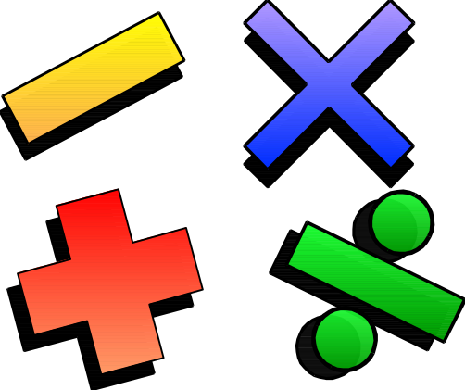
Example: Abstraction
Student
Professor
Course Offering (9:00 a.m.,
Monday-Wednesday-Friday)
Course (e.g. Algebra)
Notes:
The following are examples of abstraction:
A student is a person enrolled in classes in the university.
A professor is a person teaching classes at the university.
A course is a class offered by the university.
A course offering is a specific offering for a course including the days of the week and the times.
Explain how these are examples of abstraction.

Slide 24
What Is Encapsulation?
Hides implementation from clients.
  Clients depend on interface.
Improves Resiliency
Notes:
Encapsulation can be defined as:
The physical localization of features (for example, properties, behaviors) into a single blackbox abstraction that hides their implementation (and associated design decisions) behind a public interface. (Dictionary of Object Technology, Firesmith, Eykholt, 1995.)
Encapsulation is often referred to as “information hiding,” making it possible for the clients to operate without knowing how the implementation implements the interface.
Encapsulation eliminates direct dependencies on the implementation (clients depend on/use the interface). Thus, it’s possible to change the implementation without updating the clients as long as the interface is unchanged.
Clients are not affected by changes in implementation, thus reducing the “ripple effect,” where a correction to one operation forces the corresponding correction in a client operation and so on. As a result of encapsulation, maintenance is easier and less expensive.
Encapsulation offers two kinds of protection. It protects an object’s internal state from being corrupted by its clients and client code from changes in the object’s implementation.
Define the concept of encapsulation to the students.
Encapsulation is putting the “data bits” and operations that manipulate them in the same place.
Encapsulation does NOT allow direct manipulation of things that have been encapsulated without using the supplied interface.
An example is a car’s accelerator. Generally speaking, you put your foot down and the car goes faster. You don’t worry about the cables, electronics, engine, and the rest.

Slide 25
Objects and encapsulation
Encapsulation is one of the three cornerstones of OOP.
Hides implementation details of an object in a ‘black box’.
  Interact with object data only through the object's methods.
Allows implementor to:
  Maintain consistent object state
  Change internal implementation at will
  Test pieces of an application in isolation
  Narrow the focus of debugging

Slide 26
Encapsulation Illustrated
Professor Zheng needs to be able to teach four classes in the next semester.
Professor Zheng
AcceptCourseOffering()
SubmitFinalGrades()
Name: M Zheng
Employee ID: 567138
HireDate: 07/25/2003
Status: Tenured
Discipline: IT
MaxLoad:4
SetMaxLoad(4)
SetMaxLoad()
TakeSabbatical()
Notes:
The key to encapsulation is an object’s message interface. The object interface ensures that all communication with the object takes place through a set of predefined operations. Data inside the object is only accessible by the object’s operations. No other object can reach inside the object and change its attribute values.
For example, Professor Clark needs to have her maximum course load increased from three classes to four classes per semester. Another object makes a request to Professor Clark to set the maximum course load to four. The attribute, MaxLoad, is then changed by the SetMaxLoad() operation.
Encapsulation is beneficial in this example because the requesting object does not need to know how to change the maximum course load. In the future, the number or variables that are used to define the maximum course load may be increased, but it doesn’t affect the requesting object. It depends on the operation interface for the Professor Clark object.
Point out that the requesting object does not need to know the structure of the Professor object to request a state change.
The object that owns the attributes is the only one allowed to change its own attributes.
Note that encapsulation can also be illustrated using interfaces. However, the scope of this course does not include this discussion.

Slide 27
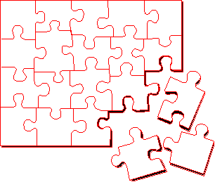
What Is Modularity?
Breaks up something complex into manageable pieces.
Helps people understand complex systems.
Notes:
Modularity can be defined as:
The logical and physical decomposition of things (for example, responsibilities and software) into small, simple groupings (for example, requirements and classes, respectively), which increase the achievements of software-engineering goals. (Dictionary of Object Technology, Firesmith, Eykholt, 1995.)
Another way to manage complexity is to break something that is large and complex into a set of smaller, more manageable pieces. These pieces can then be independently developed as long as their interactions are well understood.
Packages (described later in the course) support the definition of modular components.
Explain the concept of modularity to the students.
Modularity supports a separation of concerns.

Slide 28


Example: Modularity
For example, break complex systems into smaller modules.
Billing
System
Course
Catalog
System
Course Registration System
Student
Management
System
Notes:
Often, the system under development is too complex to understand. To better understand this, imagine that the system is broken into smaller blocks that are maintained independently. Breaking down a system in this way is called modularity. It is critical for understanding a complex system.
For example, the system under development is a Course Registration System. The system itself is too large and abstract to understand the details. Therefore, the development team broke this system into three modular systems, each independent of the others.
Billing System
Course Catalog System
Student Management System
A car is an example of modularity. It is made of up of a body, chassis, engine, wheels, and so on.

Slide 29
What Is Hierarchy?
Increasing
abstraction
Asset
BankAccount
Security
RealEstate
Decreasing
abstraction
Savings
Checking
Stock
Bond
Elements at the same level of the hierarchy should be at the same level of abstraction.
Notes:
Hierarchy can be defined as:
Any ranking or ordering of abstractions into a tree-like structure. Kinds: Aggregation hierarchy, class hierarchy, containment hierarchy, inheritance hierarchy, partition hierarchy, specialization hierarchy, type hierarchy. (Dictionary of Object Technology, Firesmith, Eykholt, 1995.)
Hierarchy organizes in a particular order or rank (for example, complexity, responsibility, and so on). This organization is dependent on perspective. Using a hierarchy to describe differences or variations of a particular concept provides for more descriptive and cohesive abstractions and a better allocation of responsibility.
In any one system, there may be multiple abstraction hierarchies (for example, a financial application may have different types of customers and accounts).
Hierarchy is neither an organizational chart nor a functional decomposition.
Hierarchy is a taxonomic organization. The use of hierarchy makes it easy to recognize similarities and differences. For example, botany organizes plants into families. Chemistry organizes elements into a periodic table.
Explain the concept of hierarchy to the students.
Hierarchy is a taxonomic organization. The use of hierarchy makes it easy to recognize similarities and differences.
A taxonomic organization is one that represents an orderly classification. For example, plants and animals are classified taxonomically.
Note that this is not part of the UML notation. UML notation is discussed later.

Slide 30
Representing Objects in the UML
An object is represented as a rectangle with an underlined name.
M Zheng :
Professor
Named Object
: Professor
Professor M Zheng
Anonymous Object
Notes:
An object is represented with a rectangle and the name of the class.
The name of the object is always underlined. To name an object, place its name before the colon.
An object can be either named or anonymous. To remain anonymous, do not include a name.
Demonstrate how an object is modeled in UML.
Many of your students may now wonder, “Hey, what is a class?” Classes are defined on the next slide.

Slide 31
Where Are We?
What is an object?
Four principles of OO
What is a class?
Polymorphism and generalization
Organizing model elements

Slide 32
What Is a Class?
A class is a description of a set of objects that share the same attributes, operations, relationships, and semantics.
  An object is an instance of a class.
A class is an abstraction in that it
  Emphasizes relevant characteristics.
  Suppresses other characteristics.
Notes:
A Class can be defined as:
A description of a set of objects that share the same attributes, operations, relationships, and semantics. (The Unified Modeling Language User Guide, Booch, 1999.)
There are many objects identified for any domain.
Recognizing the commonalties among the objects and defining classes helps us deal with the potential complexity.
The OO principle abstraction helps us deal with complexity.
Explain what a class is to the students. Remember, many of your students are not familiar with this term.
The course introduces objects before classes because objects are the things that actually do most of the work. Classes are the templates for the objects.

Slide 33
A Sample Class
Class
Course
Properties
Name
Location
Days offered
Credit hours
Start time
End time
Behavior
Add a student
Delete a student
Get course roster
Determine if it is full
Notes:
The class “Course” is an abstraction of the real-world representation of a college course. The class has properties: name, location, days offered, credit hours, start time, and end time. It also has behavior, like adding and deleting a student to the class, retrieving a current course roster, and determining if the course is full.
The class does not represent a specific course like Algebra 101 or Theatre Arts 102. Rather, it is a description of the types of properties and behavior a typical course may have.
Point out the differences between a class and an object.
Emphasize that a class is not an object.
These properties are not “filled in” to represent a specific course. Rather, it serves as a template.

Slide 34
Representing Classes in the UML
A class is represented using a rectangle with three compartments:
  The class name
  The structure (attributes)
  The behavior (operations)
Professor
- name
- employeeID : UniqueId
- hireDate
- status
- discipline
- maxLoad
+ submitFinalGrade()
+ acceptCourseOffering()
+ setMaxLoad()
+ takeSabbatical()
+ teachClass()
Notes:
The UML notation for a class permits you to see an abstraction apart from any specific programming language, which lets you emphasize the most important parts about an abstraction – its name, attributes, and operations.
Graphically, a class is represented by a rectangle.
The UML represents public visibility with a plus (+) symbol and private visibility with a minus (-) symbol.
Demonstrate how a class is modeled in UML.
Tell them that the UML represents public visibility with a plus (+) symbol and private visibility with a minus (-) symbol. Do not discuss protected visibility.

Slide 35
The Relationship between Classes and Objects
A class is an abstract definition of an object.
  It defines the structure and behavior of each object in the class.
  It serves as a template for creating objects.
Classes are not collections of objects.
Professor
Professor Zheng
Professor Wang
Professor Li
Notes:
A class is a description of a set of objects that share the same responsibilities, relationships, operations, attributes, and semantics.
A class defines an object. A class defines a template for the structure and behavior of all its objects. The objects created from a class are also called the instances of the class.
The class is the static description and the object is the run-time instance of that class.
Modeling is from real-world objects. Software objects are based on the real-world objects, but exist only in the context of the system.
Use real-world objects, abstract out what you don't care about. Then, take these abstractions and go through the process of classification based on what you do care about. Classes in the model are the result of this classification process.
These classes are then used as templates within an executing software system to create software objects. These software objects represent the real-world objects you originally started with.
Some classes/objects may be defined that don't represent real-world objects. They are there to support the design and are "software only.”
Show how classes and objects are related.
Classic example: A class is to an object what a cookie cutter is to a cookie.

Slide 36
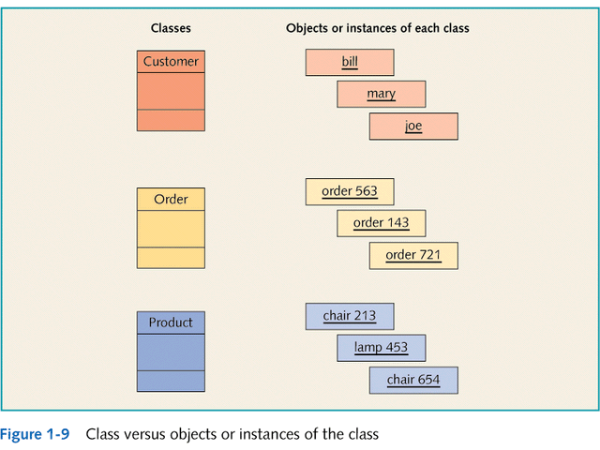

Slide 37
What Is an Attribute?
An attribute is a named property of a class that describes the range of values that instances of the property may hold.
  A class may have any number of attributes or no attributes at all.
Student
- name
- address
Attributes
- studentID
- dateOfBirth
Notes:
An Attribute can be defined as:
A named property of a class that describes the range of values that instances of the property may hold. (The Unified Modeling Language User Guide, Booch, 1999.)
A class may have any number of attributes or no attributes at all. At any time, an object of a class has specific values for every one of its class’s attributes.
An attribute defined by a class represents a named property of the class or its objects. An attribute defines the type of its instances.
An attribute has a type, which tells us what kind of attribute it is. Typical attributes are integer, Boolean, real, and enumeration. These are called primitive types. An attribute does not need to be a primitive type though.
Define the term attribute for the students.
Remember, there are still operations in this class, but choose to suppress them.

Slide 38
Attributes in Classes and Objects
Class
:Student
- name = “M. Zheng”
- address = “123 Main St.”
Student
- studentID = 9
- name
- dateOfBirth = “03/10/1974”
- address
- studentID
Objects
- dateOfBirth
:Student
- name = “D. Wang”
- address = “456 Oak Ln.”
- studentID = 2
- dateOfBirth = “12/11/1969”
Notes:
At the class level, the Student class attributes indicate that the Students have names, addresses, studentIDs, and a date of birth.
At the object level, the attributes indicate the values for the name, address, studentID, and date of birth.
Only the class instance (objects) should be able to change the value of the attributes.
The state of an object is defined by the value of its attributes and the existence of links to other objects.
Show that an attribute is defined on a class and instantiated on an object.

Slide 39
What Is an Operation?
A service that can be requested from an object to effect behavior. An operation has a signature, which may restrict the actual parameters that are possible.
A class may have any number of operations or none at all.
Student
+ get tuition()
+ add schedule()
Operations
+ get schedule()
+ delete schedule()
+ has prerequisites()
Notes:
An Operation can be defined as:
A service that can be requested from an object to effect behavior. An operation has a signature, which may restrict the actual parameters that are possible.
The operations in a class describe what the class can do.
An operation can either be a command or a question. A question should never change the state of the object. Only a command can change the state of the object.
An operation is described with a return-type, name, and zero or more parameters. Together, the return-type, name, and parameters are called the signature of the operation.
The outcome of the operation depends on the current state of the object. Often, but not always, invoking an operation on an object changes the object’s data or state.
Define the term operation for the students.
Point out that these should be called operations. Many people use the term methods instead of operations.
In the UML, methods and operations are NOT synonymous and have distinct definitions.
An operation is simply the advertisement of a service that is offered by a class. A method is the actual code that realizes that operation.

Slide 40
Where Are We?
What is an object?
Four principles of OO
What is a class?
Polymorphism and generalization
Organizing model elements

Slide 41
What Is Polymorphism?
The ability to hide many different implementations behind a single interface.
Manufacturer B
Manufacturer C
Manufacturer A
OO Principle:
Encapsulation
Remote Control
Notes:
The Greek term polymorphos means “having many forms.” Every implementation of the interface must include at least the interface. In some cases, the implementation can include more than the interface.
For example, a remote control can be used to monitor/support any type of television that relates to a specific interface (the specific interface the remote was designed to be used with).
Define the term polymorphism for the students.
In a nutshell, polymorphism means that different things respond in different ways to the same command. For example, if you told your class to relax each one of the students would do something different, but they would still relax.

Slide 42
Example: Polymorphism
financialInstrument.getCurrentValue()
getCurrentValue()
getCurrentValue()
getCurrentValue()
Stock
Bond
Mutual Fund
Notes:
In this example, a requesting object would like to know the current value of a financial instrument. However, the current value for each financial instrument is calculated in a different fashion. The stock needs to determine the current asking price in the financial market that it is listed under. The bond needs to determine the maturity timelines and interest rates. A mutual fund needs to check the day’s closing price from the fund management company.
In a non object-oriented development environment, you would write code that may look something like this:
IF financialInstrument = Stock THEN
calcStockValue()
ELSEIF financialInstrument = Bond THEN
calcBondValue()
ELSEIF financialInstrument = MutualFund THEN
calcMutualFundValue()
With object technology, each financial instrument can be represented by a class, and each class would know how to calculate its own value. The requesting object simply needs to ask the specific object (for example, Stock) to get its current value. The requesting object does not need to keep track of three different operation signatures. It only needs to know one. Polymorphism allows the same message to be handled in different ways depending on the object that receives it.
This diagram shows how three different objects can have the same operation: getCurrentValue().
However, the way each interprets that operation is unique because the current value for each instrument is dependent on different variables.
Point out how the requesting object does not need to know anything about the calculations or the differences. All that it cares about is that the current value is calculated.
One of the huge benefits of polymorphism is that the calling object does not need to know what type of object it is calling. In this example, it doesn’t care what type of asset it gets the value from, just that it gets the value.

Slide 43
Polymorphism
Polymorphism
  literally means “many forms”
  in Java means using the same message (or method name) with different classes
    different objects can respond in their own way to the same message
    e.g. toString()

Slide 44
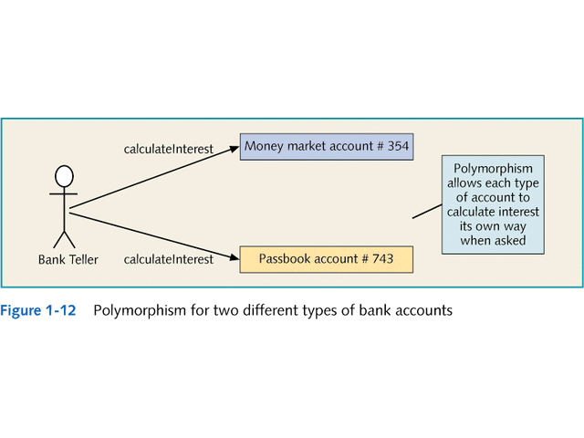

Slide 45
What Is an Interface?
A declaration of a coherent set of public features and obligations.
  A contract between providers and consumers of services. Examples of interfaces are:
    Provided interface - The interfaces that the element exposes to its environment.
    Required interface - The interfaces that the element requires from other elements in its environment in order to be able to offer its full set of provided functionality.
Notes:
Interfaces are not abstract classes, as abstract classes allow you to provide default behavior for some/all of their methods. Interfaces provide no default behavior.
Interfaces are the key to the “plug-and-play” ability of an architecture: Any classifiers (for example, classes, subsystems, components) that realize the same interfaces may be substituted for one another in the system, thereby supporting the changing of implementations without affecting clients.
Interfaces formalize polymorphism.They allow us to define polymorphism in a declarative way, unrelated to implementation. Two elements are polymorphic with respect to a set of behaviors if they realize the same interfaces. In other words, if two objects use the same behaviors to get different, but similar results, they are considered to be polymorphic. A cube and a pyramid can both be drawn, moved, scaled, and rotated, but they look very different.
You have probably heard that polymorphism is one of the big benefits of object orientation, but without interfaces there is no way to enforce it, verify it, or even express it except in informal or language-specific ways. Formalization of interfaces strips away the mystery of polymorphism and gives us a good way to describe, in precise terms, what polymorphism is all about. Interfaces are testable, verifiable, and precise.

Slide 46
Example: A Provided Interface
Elided/Iconic Representation
(“ball”)
Manufacturer A
Manufacturer B
Remote Sensor
Manufacturer C
Canonical (Class/Stereotype) Representation
Manufacturer A
<<interface>>
RemoteSensor
Manufacturer B
Manufacturer C
Notes:
The ball notation is best used when you only need to denote the existence of an interface. If you need to see the details of the interface (for example, the operations), then the class/stereotype representation is more appropriate.
From The Random House Collegiate Dictionary:
Elide: to pass over; omit; ignore.
Canonical: authorized; recognized; accepted.
According to the UML User Guide, there are two ways to represent a realizes relationship with an interface. The elided form (“ball”) is useful when you want to expose the seams of the system. However, there is a limitation in that you can’t visualize the operations on the interface.
The second way, canonical, allows you to visualize the operations on the interface.
The implementation dependency from a classifier to an interface is shown by representing the interface with a circle or ball, labeled with the name of the interface and attached by a solid line to the classifier that implements this interface.

Slide 47
Example: A Required Interface
Elided/Iconic Representation
(“socket”)
Remote Control
Remote Sensor
<<interface>>
Canonical (Class/Stereotype) Representation
Remote Control
Remote Sensor
Notes:
The socket notation is best used when you only need to denote the existence of an interface. If you need to see the details of the interface (for example, the operations), then the class/stereotype representation is more appropriate.
From The Random House Collegiate Dictionary:
Elide: to pass over; omit; ignore.
Canonical: authorized; recognized; accepted.
The elided form (“socket”) is useful when you want to expose the seams of the system. However, there is a limitation in that you can’t visualize the operations on the interface.
The second way, canonical, allows you to visualize the operations on the interface.
The usage dependency from a classifier to an interface is shown by representing the interface with a half-circle or socket, labeled with the name of the interface and attached by a solid line to the classifier that implements this interface.

Slide 48
Example: Connecting Interfaces
Manufacturer A
Remote Control
Manufacturer B
Remote Sensor
Manufacturer C
Manufacturer A
<<interface>>
Remote Control
RemoteSensor
Manufacturer B
Manufacturer C

Slide 49
What Is Generalization?
A relationship among classes where one class shares the structure and/or behavior of one or more classes.
Defines a hierarchy of abstractions in which a subclass inherits from one or more superclasses.
  Single inheritance.
  Multiple inheritance.
Is an “is a kind of” relationship.
Notes:
Generalization can be defined as:
A specialization/generalization relationship, in which objects of the specialized element (the child) are substitutable for objects of the generalized element (the parent). (The Unified Modeling Language User Guide, Booch, 1999.)
The subclass may be used where the superclass is used, but not vice versa.
The child inherits from the parent.
Generalization is transitive. You can always test your generalization by applying the “is a kind of” rule. You should always be able to say that your generalized class “is a kind of” the parent class.
The terms “generalization” and “inheritance” are generally interchangeable, but if you need to distinguish, generalization is the name of the relationship. Inheritance is the mechanism that the generalization relationship represents/models.
Inheritance can be defined as:
The mechanism by which more specific elements incorporate the structure and behavior of more general elements. (The Unified Modeling Language User Guide, Booch, 1999.)
Single inheritance: The subclass inherits from only one superclass (has only one parent).
Multiple inheritance: The subclass inherits from more than one superclass (has multiple parents).
Introduce the concept of generalization. Remember, many of your students are not familiar with this term.
Generalization relationships are also permitted between packages. However, packages do not have semantics. Therefore, generalization between packages is not common.
According to Grady Booch:
The terms “inheritance” and “generalization” are, practically speaking, interchangeable. The UML standard calls a relationship “generalization” so as not to confuse people with language-specific meanings of inheritance.
To confuse matters more, some call this an “is-a” or a “kind of” relationship (especially those into conceptual modeling in the cognitive sciences).
So, for most users, it’s fair to use either term. For power users, people who care about things like the UML metamodel and specifying formal semantics of the same, the relationship is called “generalization” and applying such a relationship between two classes, for example, results in the subclass inheriting the structure and operations of the superclass (inheritance is the mechanism).

Slide 50
Example: Single Inheritance
One class inherits from another.
Ancestor
Account
- balance
Superclass (parent)
- name
- number
+ withdraw()
+ createStatement()
Generalization Relationship
Subclasses
(children)
Savings
Checking
Descendents
Notes:
The generalization is drawn from the subclass class to the superclass/parent class.
The terms “ancestor” and “descendent” may be used instead of “superclass” and “subclass.”

Slide 51
Example: Multiple Inheritance
A class can inherit from several other classes.
FlyingThing
Animal
Multiple Inheritance
Airplane
Helicopter
Bird
Wolf
Horse
Use multiple inheritance only when needed and
always with caution!
Notes:
Multiple inheritance means that a class can inherit several other classes. For example, Bird inherits from both FlyingThing and Animal.
Multiple inheritance is conceptually straight forward and may be needed to model the real world accurately. However, there are potential implementation problems when you use multiple inheritance, as not all implementation languages support it. Thus, be judicious with your use of multiple inheritance. Use it only where it accurately describes the concept and reduces the complexity of your model. Be aware, however, that this representation probably needs to be adjusted in design and implementation.
Generally, a class inherits from only one class.
Provide an example of generalization.
Some languages do not support multiple inheritance.

Slide 52
What Is Inherited?
A subclass inherits its parent’s attributes, operations, and relationships.
A subclass may:
  Add additional attributes, operations, relationships.
  Redefine inherited operations. (Use caution!)
Common attributes, operations, and/or relationships are shown at the highest applicable level in the hierarchy.
Inheritance leverages the similarities among classes.
Notes:
Generalization is more than finding common attributes, operations, and relationships. It is more about the responsibilities and essence of the classes.
Explain how generalization works.
Emphasize that when a change is made to a super class, all descendent classes inherit the change.

Slide 53
Object Interactions and Messages
Objects interact with other objects in a variety of relationships
  e.g. one-to-one, one-to-many
Messages
  The means by which objects interact
  Example:
    User initiates interaction via messages to GUI objects
    GUI objects interact with problem domain objects via messages
    Problem domain objects interact with each other and GUI objects via messages
    GUI objects respond to user via messages

Slide 54
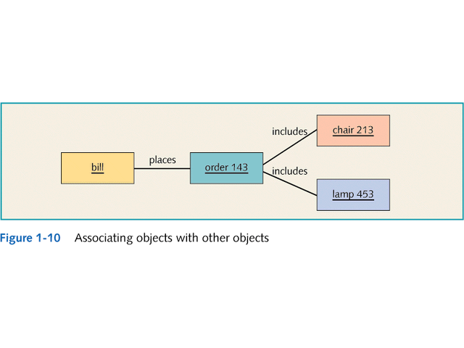

Slide 55
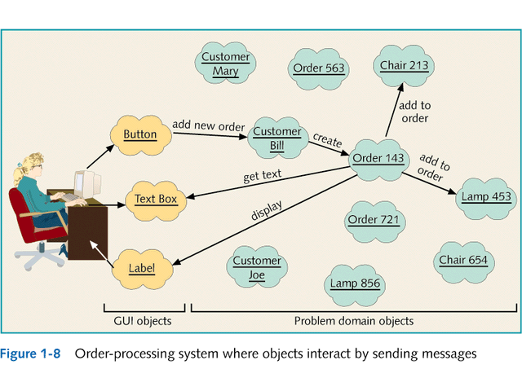

Slide 56
Learning OO Development
Introducing Three-Tier Design
  Objects that interact in OO system are separated into three categories of classes:
    Problem domain classes
      Specific to a particular business application
    GUI classes
      Define objects that make up the UI to the application
    Data access classes
      Work with DBMS to store/retrieve object information

Slide 57
Unified Modeling Language (UML)
Standard OOA&D modeling notation
Uses model-driven approach
  Enables creation of graphical models of the system requirements and system design
Components include
  Class diagrams
  Use Case diagrams
  Sequence diagrams
  Statecharts

Slide 58
Visual Modeling with the Unified Modeling Language
Static Diagrams
Class
Diagrams
Use-Case
Diagrams
Sequence
Diagrams
Object
Diagrams
Communication
Diagrams
Component
Diagrams
Models
Dynamic Diagrams
State Machine
Diagrams
Deployment
Diagrams
Activity
Diagrams
Notes:
In building a visual model of a system, many different diagrams are needed to represent different views of the system. The UML provides a rich notation for visualizing models. This includes the following key diagrams:
Use-case diagrams to illustrate user interactions with the system
Class diagrams to illustrate logical structure
Object diagrams to illustrate objects and links
Component diagrams to illustrate physical structure of the software
Deployment diagrams to show the mapping of software to hardware configurations
Activity diagrams to illustrate flows of events
State Machine diagrams to illustrate behavior
Interaction diagrams (that is, Communication and Sequence diagrams) to illustrate behavior
This is not all of the UML diagrams, just a representative sample.
The UML provides a graphical language for representing models but provides little or no guidance on when and how to use these diagrams. This is an area in which the RUP helps. It describes the kinds of project artifacts needed, including diagrams, and puts them in the context of an overall project plan.

Slide 59
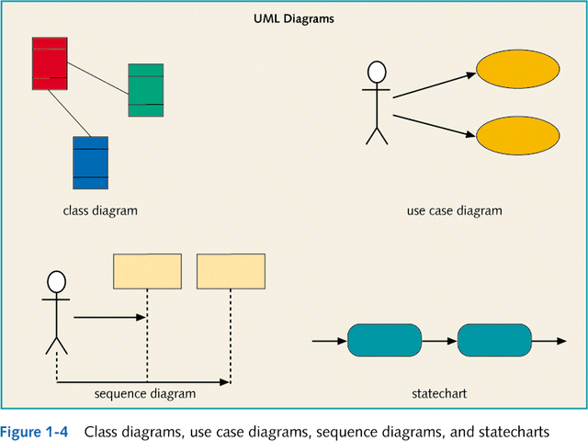

Slide 60
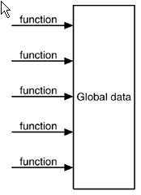
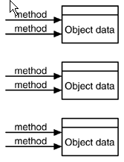
OOP vs. Traditional Procedural Programming

Slide 61
Continue
Procedural Programming:
  The code works in list-type, or procedure-based, fashion.
Object Oriented Programming(OOP)
  Instead of writing a list of things (procedural programming) , you write objects--- the things that related to a certain kind of work.
  When you do OOP, you try to think about what objects you want to create and then you try to specify those objects in your code

Slide 62
More on Objects

Slide 63
Review: The Relationship Between Classes and Objects
A class is an abstract definition of an object.
  It defines the structure and behavior of each object in the class.
  It serves as a template for creating objects.
Classes are not collections of objects.
Professor Torpie
Professor
Professor Meijer
Professor Allen
Notes:
A class is a description of a set of objects that share the same responsibilities, relationships, operations, attributes, and semantics.
An object is defined by a class. A class defines a template for the structure and behavior of all its objects. The objects created from a class are also called the instances of the class.
The class is the static description; the object is a run-time instance of that class.
Since we model from real-world objects, software objects are based on the real-world objects, but they exist only in the context of the system.
Starting with real-world objects, abstract out what you do not care about. Then, take these abstractions and categorize, or classify them, based on what you do care about. Classes in the model are the result of this classification process.
These classes are then used as templates within an executing software system to create software objects. These software objects represent the real-world objects we originally started with.
Some classes/objects may be defined that do not represent real-world objects. They are there to support the design and are "software only.”
A class is to an object what a cookie cutter is to a cookie.

Slide 64
Review: Class Relationships
“The semantic connection between classes” ~ Grady Booch
Class diagrams may contain the following relationships:
  Association
  Aggregation
  Composition
  Generalization
  Dependency
  Realization
OR
OR
OR
Notes:
The next several slides will explain and define each of these relationships.

Slide 65
What Is Navigability?
Indicates that it is possible to navigate from a associating class to the target class using the association
RegistrationController
Schedule
CourseOffering
Notes:
The navigability property on a role indicates that it is possible to navigate from a associating class to the target class using the association. This may be implemented in a number of ways: by direct object references, associative arrays, hash-tables, or any other implementation technique that allows one object to reference another.
Navigability is indicated by an open arrow placed on the target end of the association line next to the target class (the one being navigated to). The default value of the navigability property is true (associations are bi-directional by default).
In the course registration example, the association between the Schedule and the Course Offering is navigable in both directions. That is, a Schedule must know the Course Offering assigned to the Schedule, and the Course Offering must know the Schedules it has been placed in.
When no arrowheads are shown, the association is assumed to be navigable in both directions.
In the case of the association between Schedule and Registration Controller, the Registration Controller must know its Schedules, but the Schedules have no knowledge of the Registration Controllers (or other classes). As a result, the navigability property of the Registration Controller end of the association is turned off.
Double-headed arrows are also valid for bi-directional associations.

Slide 66
Review: What Is an Association?
The semantic relationship between two or more classifiers that specifies connections among their instances
  A structural relationship, specifying that objects of one thing are connected to objects of another
Student
Schedule
Course
Notes:
An association can be defined as:
The semantic relationship between two or more classifiers that specifies connections among their instances. In other words, an association is a structural relationship that specifies that objects (instances of classes) are connected to other objects.
The way that we show relationships between classes is through the use of associations. Associations are represented on class diagrams by a line connecting the associating classes. Data may flow in either direction or in both directions across a link.
Most associations are simple. That is, they exist between exactly two classes. They are drawn as solid paths connecting pairs of class symbols. Ternary relationships are also possible.
Sometimes, a class has an association to itself. This does not always mean that an instance of that class has an association to itself. More often, it means that one instance of the class has associations to other instances of the same class.
This example shows that a student object is related to a schedule object. The course class demonstrates how a course object can be related to another course object.
Draw these examples on the board as objects to help the students understand the concept.

Slide 67
Review: What Is Multiplicity?
Multiplicity is the number of instances one class relates to ONE instance of another class.
For each association, there are two multiplicity decisions to make, one for each end of the association.
  For each instance of Professor, many Course Offerings may be taught.
  For each instance of Course Offering, there may be either one or zero Professor as the instructor.
Professor
+ instructor
CourseOffering
0..1
0..*
Notes:
Multiplicity can be defined as:
The number of instances of one class that relate to one instance of another class.
For each role, you can specify the multiplicity of its class and how many objects of the class can be associated with one object of the other class.
Multiplicity is indicated by a text expression on the role. The expression is a comma-separated list of integer ranges.
It is important to remember that multiplicity is referring to instances of classes (objects) and their relationships. In this example, a Course Offering object can have either zero or one Professor object related to it. Conversely, a Professor object can have zero or more Course Offering objects related to it.
Multiplicity must be defined on both ends of the association.

Slide 68
Review: Multiplicity Indicators
Unspecified
Exactly One
1
Zero or More
0..*
Zero or More
*
One or More
1..*
Zero or One (optional scalar role)
0..1
Specified Range
2..4
Multiple, Disjoint Ranges
2, 4..6
Notes:
Multiplicity is indicated by a text expression on the role.
The expression is a comma-separated list of integer ranges.
A range is indicated by an integer (the lower value), two dots, followed by another integer (the upper value).
A single integer is a valid range, and the symbol “*” indicates "many.” That is, an asterisk “*” indicates an unlimited number of objects.
The symbol “*” by itself is equivalent to “0..*” That is, it represents any number, including none. This is the default value.
An optional scalar role has the multiplicity 0..1.
The use of “N” instead of “*” is from Booch, not UML. For example, the use of “0..N” and “N” is not UML.
The multiplicity specified for a relationship is for all instances of that relationship, not simply for a particular use-case realization or for a particular point in time.

Slide 69
Review: What Is Aggregation?
An aggregation is a special form of association that models a whole-part relationship between an aggregate (the whole) and its parts.
  An aggregation is an “Is a part-of” relationship.
Multiplicity is represented like other associations.
Student
Schedule
1
0..1
Notes:
An aggregation can be defined as:
A special form of association that models a whole-part relationship between an aggregate (the whole) and its parts.
Aggregation is used to model relationships between model elements. There are many examples of aggregation: a library contains books, departments are made up of employees, a computer is composed of a number of devices. To model an aggregation, the aggregate (department) has an aggregation association to the its constituent parts (employee).
A hollow diamond is attached to the end of an association path on the side of the aggregate (the whole) to indicate aggregation.
An aggregation relationship that has a multiplicity greater than one for the aggregate is called shared. Destroying the aggregate does not necessarily destroy the parts. By implication, a shared aggregation forms a graph or a tree with many roots. Shared aggregations are used where there is a strong relationship between two classes. Therefore, the same instance can participate in two different aggregations.

Slide 70
What Is Composition?
A composition is a stronger form of association in which the composite has sole responsibility for managing its parts – such as their allocation and deallocation.
It is shown by a diamond filled adornment on the opposite end.
Student
1
Schedule
0..*
Notes:
The relationship from Student to Schedule is modeled as a composition because if you got rid of the Student, you would get rid of any Schedules for that Student. Here are some general rules for when to use composition.
Use composition when:
Properties need independent identities
Multiple classes have the same properties
Properties have a complex structure and properties of their own
Properties have complex behavior of their own
Properties have relationships of their own
Otherwise use attributes
Composition and attributes are semantically equivalent. It just depends on what you need to model to make your system understandable.
Classes are capable of expressing structure, relationships, and more complex behavior. If you need any of these, use a class. The next slide shows an example of composition within a structured diagram.

Slide 71
Relationships: Dependency
A relationship between two model elements where a change in one may cause a change in the other
Non-structural, “using” relationship
Dependency
relationship
Class
Client
Supplier
Dependency
relationship
Component
Client
Supplier
The <<use>> stereotype is
implicit and does not need
to be shown.
Dependency
relationship
Package
ClientPackage
SupplierPackage
Notes:
A dependency relationship is a weaker form of relationship showing a relationship between a client and a supplier where the client does not have semantic knowledge of the supplier.
A dependency relationship denotes a semantic relationship between model elements, where a change in the supplier may cause a change in the client.
Structural versus non-structural relationships will be discussed in depth in the Class Design module.

Slide 72
Relationships: Realization
One classifier serves as the contract that the other classifier agrees to carry out, found between:
  Interfaces and the classifiers that realize them
  Use cases and the collaborations that realize them
One classifier serves as the contract that the other classifier agrees to carry out, found between:
  Interfaces and the classifiers that realize them
  Use cases and the collaborations that realize them
<<interface>>
InterfaceName
Component
Class
<<interface>>
InterfaceName
<<interface>>
<<subsystem>>
InterfaceName
Subsystem
Collaboration
UseCase
Notes:
We discussed subsystems earlier in this module. We will look at interfaces and the realization relationship in more detail in the Identify Design Elements module.
Realization is a semantic relationship between two classifiers. One classifier serves as the contract that the other classifier agrees to carry out.
The realizes relationship is a combination of a dependency and a generalization. It is not true generalization, as only the “contract” (that is to say, operation signature) is “inherited.” This “mix” is represented in its UML form, which is a combination of dependency and generalization.
The realizes relationship may be modeled as a dashed line with a hollow arrowhead pointing at the contract classifier (canonical form), or when combined with an interface, as a “ball” (elided form).
Again, from The Random House Collegiate Dictionary:
Elide: to pass over; omit; ignore.
Canonical: authorized; recognized; accepted.

Slide 73
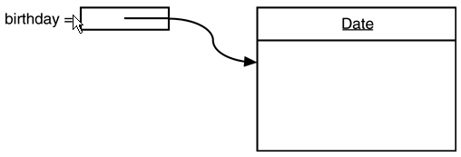
Object variables
An object variable is a reference to an object.
Declaring a variable does not create an object.
To create an object, use new to invoke the object's constructor:
  Date birthday; // declares a date
  birthday = new Date(); // creates a Date object
Access methods and fields of an object with the 'dot' syntax:
  double x = employee27.getSalary();

Slide 74
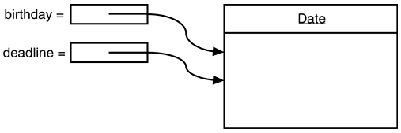
Object variables (2)
Several object variables can refer to the same object.
Changes through one reference are visible through all references:
  Date birthday = new Date();
  Date anniversary = birthday;
  anniversary.add(Calendar.DAY,1);
  --> birthday changes too!
This is a common source of programming errors!

Slide 75
Object variables (3)
The special value null refers to no object.
  Date halloween = null;
Unlike field variables, local object variables (inside a method) are not initialized to null by default; make sure you always provide an initializer.

Slide 76
Class

Slide 77
Defining Classes
Classes are defined in Java using the following format:
<access modifier> class <ClassName> {
}
for example:
public class Employee {
}
Access modifiers define what classes can access this class.
Valid access modifiers for class are:
  Public: means all other classes can access this class.
  Abstract: (we will go over abstract classes later)
  Final: (we will go over final classes later)
If no access modifier is declared, it defaults to public
The naming convention for the name of a class (ClassName)
states that classes should begin with a capital letter.

Slide 78
A simple class definition
public class SimplePoint2D
{
public SimplePoint2D(double x_coord, double y_coord)
{
x = x_coord;
y = y_coord;
}
public double getX()
{
return x;
}
public double getY()
{
return y;
}
private double x, y; // fields of the object
}

Slide 79
Simple class definition (2)
public class TestSimplePoint2D
{
public static void main(String argv[])
{
SimplePoint2D a;
a = new SimplePoint2D(3.0,4.0);
SimplePoint2D b = new SimplePoint2D(4.0,3.0);
System.out.println(a.getX()+" "+b.getX());
}
}

Slide 80

EmployeeTest.java
Note:
1. It has two classes
EmployeeTest
Employee in a single source file.
Prefer to put each class into its own source file
import java.util.*;
public class EmployeeTest
{
public static void main(String[] args)
{
// fill the staff array with three Employee objects
Employee[] staff = new Employee[3];
staff[0] = new Employee("Carl Cracker", 75000,
1987, 12, 15);
staff[1] = new Employee("Harry Hacker", 50000,
1989, 10, 1);
staff[2] = new Employee("Tony Tester", 40000,
1990, 3, 15);
// raise everyone's salary by 5%
for (int i = 0; i < staff.length; i++)
staff[i].raiseSalary(5);
// print out information about all Employee objects
for (int i = 0; i < staff.length; i++)
{
Employee e = staff[i];
System.out.println("name=" + e.getName()
+ ",salary=" + e.getSalary()
+ ",hireDay=" + e.getHireDay());
}
}
}

Slide 81
EmployeeTest.java when compiling, the compiler creates two class files in the directory: EmployeeTest.class Employee.class
class Employee
{
public Employee(String n, double s,
int year, int month, int day)
{
name = n;
salary = s;
GregorianCalendar calendar
= new GregorianCalendar(year, month - 1, day);
// GregorianCalendar uses 0 for January
hireDay = calendar.getTime();
}
public String getName()
{
return name;
}
public double getSalary()
{
return salary;
}
public Date getHireDay()
{
return hireDay;
}
public void raiseSalary(double byPercent)
{
double raise = salary * byPercent / 100;
salary += raise;
}
private String name;
private double salary;
private Date hireDay;
}

Slide 82
Fields

Slide 83
Defining Fields (Variables)
Variables are defined in Java using the following format :
<access modifier> <type> <variable name>;
e.g. public String name;
private int count;
Valid access modifiers for fields are:
Public: available to all methods and classes
Private: available only to methods in the class.
Protected: available only to methods in the class,
it’s children, and other classes in the same package.
Static: (we will learn about this later)
Naming conventions for methods state that method name should begin
with a lower case letter.

Slide 84
Encapsulation
In general, classes are usually public to promote reuse
In a public class, it is generally a good idea to make:
  variables private
  methods public
This is the idea behind Encapsulation.
Encapsulation refers to the idea of information hiding.
  allows other classes to reuse code
  calling a method with the appropriate arguments
  no need to know the inner workings of the method
  no need to reinvent the wheel

Slide 85
Instance fields
Objects use instance fields to store state.
  As an example, a bank account object would include an instance field to store its current balance.
Each object of a class has its own copies of the instance fields.
Fields can be:
  public --- accessible by any other class
  private --- accessible only by an object of the same class
  protected --- accessible by the class and any subclass

Slide 86
Instance fields (2)
Instance fields should be private to enforce encapsulation, and provide accessor and mutator methods to access instance fields.
By convention, these method names start with 'get' and 'set': the methods for variable ‘Name' are called getName() and setName().
An accessor method should not return a reference to a mutable object:
  Date getBirthdate()
  { return birthdate; } // wrong!
Instead, return a clone of the instance field object (more on this later in the course).

Slide 87
Instance fields (3)
The private fields of an object are accessible to any other object of the class.
This allows usages like:
  public class ClassOne
  {
  private int myField;
  public boolean equals(ClassOne other)
  {
  return this.myField == other.myField;
  }
  …
  }

Slide 88
Final Instance and Class Variables
Variables declared as final never change their value. They are constants.
A final instance variable is set when an object is created and doesn’t change.
A final class (or static) variable is set at the class level before any instances are created.
Naming convention for final static variables is in all caps.
Example of final variables:
public class Employee {
// max is a final class (or static) variable
public static final INCHES_PER_FOOT=12;
// name is a final instance variable
private final String name;
}
}

Slide 89
Overriding a variable
Overriding:
If you declare a variable within a class, and use the same variable name within a method of the class, then the variable used inside the method takes precedence, or overrides, the first variable

Slide 90
Static
Can have static
  Instance variables
  Methods
Static variables and methods
  Are associated with the class itself!!
  Not associated with the object
Therefore Statics can be accessed without instantiating an object!

Slide 91
Static fields
An instance field marked static is a class variable, shared by all objects of the class.
Class variables are useful for:
  Keeping track of all objects of a class.
  Assigning unique identifiers to objects.

Slide 92
Static Fields
Like a global variable
  But on a class by class basis
  Stored in the class
Static variable occurs as a single copy in the class
  Instance variables occur as multiple copies – one in each instance (object)
Example
  System.out is a static variable!

Slide 93
Static Methods
Like a “global function”
  Again on a class by class basis
No Receiver!
  Since the static method is associated with the class, there is no object that is associated with it and therefore, no “receiver”
  You can think of it as the class being the receiver.
Example
  System.arrayCopy() is a static method

Slide 94
Static Gotcha!
Cannot refer to a non-static instance variable in a static method
  There is no receiver (no object)
  So the instance variable doesn’t exist!
Example
  public static int getCount() {
  units = units + 1; // error
  }

Slide 95
Static Fun
Class: Student
static numStudents: 2
static method: getNumStudents()
Object: bart
Type: Student
Name: Bart Simpson
Age: 10
Methods: eat(), run() walk()
Object: bart
Type: Student
Name: Bart Simpson
Age: 10
Object: lisa
Type: Student
Name: Lisa Simpson
Age: 5
Methods: eat(), run() walk()

Slide 96
Static Example
public class Student {
private int studentId;
private String studentName;
// Define a static int counter
private static int count = 0;
public Student(int id, String name) {
studentId = id;
studentName = name;
// Increment the counter
count++;
}
public static int getCount() {
// Clients invoke this method as Student.getCount();
// Does not execute against a receiver, so
// there is no “id“ and “name” to refer to here
return(count);
}
// rest of the Student class
...
}

Slide 97
Class Methods and Variables vs. Instance Methods and Variables
Instance variables:
  variable that is associated with an instance of a class and is associated with an object uniquely
  e.g. employeeId
Instance methods:
  execute within the context of an instance
  affect only that particular object

Slide 98
Class Methods and Variables vs.
Instance Methods and Variables
Class variable (or static field):
  is a variables that is associated with a class and is shared by all instances of a class
  exist even if no instances of the class exist
  declared with the static keyword
  e.g. count
Class methods (or static methods):
  exist even if no instances of class exist
  declared with the static keyword
  cannot refer to instance variables, can use static variables
  useful for utility methods as in the Math class
  e.g. main() method is a class method

Slide 99
StaticTest.java
public class StaticTest
{
public static void main(String[] args)
{
// fill the staff array with three Employee objects
Employee[] staff = new Employee[3];
staff[0] = new Employee("Tom", 40000);
staff[1] = new Employee("Dick", 60000);
staff[2] = new Employee("Harry", 65000);
// print out information about all Employee objects
for (int i = 0; i < staff.length; i++)
{
Employee e = staff[i];
e.setId();
System.out.println("name=" + e.getName()
+ ",id=" + e.getId()
+ ",salary=" + e.getSalary());
}
int n = Employee.getNextId(); // calls static method
System.out.println("Next available id=" + n);
}
}
class Employee
{
public Employee(String n, double s)
{
name = n;
salary = s;
id = 0;
}

Slide 100
public String getName()
{
return name;
}
public double getSalary()
{
return salary;
}
public int getId()
{
return id;
}
public void setId()
{
id = getNextid(); // set id to next available id
}
public static int getNextId()
{
return nextId++; // returns static field
}
public static void main(String[] args) // unit test
{
Employee e = new Employee("Harry", 50000);
System.out.println(e.getName() + " " + e.getSalary());
}
private String name;
private double salary;
private int id;
private static int nextId = 0;
}

Slide 101
Default field values
Without explicit initialization, instance fields are set to default values:
  numeric variables are set to zero
  object variables are set to null
  boolean variables are set to false
Do not depend on this behavior!
You can initialize instance fields at declaration:
  public class Employee
  {
  private Date hireDate = new Date();
  …

Slide 102
Local Variables
Local variables are variables defined within a method.
No access modifier is needed. They can only be referenced within that method.
Unlike class and instance variables, they are not initialized automatically.
  For example, class and instance numeric variables are initialized to 0 or 0.0
Example of local variables:
public class Employee {
….
public String addToString(String s) {
// s2 is a local variable that can only be
// referenced in this method
String s2 = “ end of string”;
return s + s2;
}
}

Slide 103
Methods

Slide 104
Defining Methods
Methods are defined in Java using the following format:
<access modifier> <return type> <MethodName> (<parm list>) {
}
for example:
public boolean checkName (String name) {
if (name.equals(“Homer”))
return true;
}
Valid access modifiers for methods are:
Public: available to all other methods and classes
Private: available only to other methods in the class.
Protected: available only to other methods in the class,
it’s children, and other classes in the same package.
Static: (we will learn about this later)
Naming conventions for methods state that method name should begin
with a lower case letter.

Slide 105
Methods
As in C++, invoke an object's methods to get something done.
In Java, method names start with a lower-case letter and can be of any length.
Methods can be overloaded (as long as signatures are different).
Methods can be public, private, or protected.
When a method is invoked, it is passed a reference to its containing object as an invisible "implied argument".

Slide 106
Private methods
Make a class's methods public only when necessary.
Many methods only need to be accessible within the class.
  Such methods should be private.
If most of a class's methods are private, it's easier to change the class implementation without changing any classes that use it.

Slide 107
Static methods (Again)
A method marked static is a class method, which does not operate on an object.
Class methods don't have an associated object, and can't reference non-static fields.
Access a static method through the class name rather than through an object variable:
  double x = Math.sin(2.0);
  int i = Integer.parseInt("-99");

Slide 108
Factory methods
One use for a static method is as a factory method.
A factory method returns an object of its class, but is not a constructor.
See the slide on singleton classes for an example.

Slide 109
The main() method
The JVM calls method main() in the top-level class of an application.
Method main() must be:
  public --- or it couldn't be executed
  static --- or you'd need an object to call it with
  void --- because doesn't return anything
You can provide a main() method in any class!
  This provides a handy way to build testing code into the definition of any class.

Slide 110
Mutator and Accessor Methods
Often referred to as get/set methods.
Mutator methods modify fields in a class.
  Example:
  public void setName (String n)
  {
  empName = n;
  }
Accessor methods retrieve fields in a class
  Example:
  public String class getName ()
  {
  return empName;
  }
Be careful not to return mutatable objects in your accessor methods. Why is this important?

Slide 111
Mutator and Accessor Methods
Returning mutatable objects in public accessor methods breaks encapsulation!!!!
Even if the data element is private, outside classes can now modify it.
You should return immutable objects (Strings, ints, etc).
If you must return a reference to a mutatable object, you should clone it first.

Slide 112
Accessing Methods and Variables
the dot operator
  Math.random();
  String.length();
    e.g. String name = “Cartman”;
    int lengthOfName = name.length();
class methods and variables are referenced via the class:
  ClassName.methodName()
    e.g. Math.random()
  ClassName.fieldName
    e.g. Math.PI
instance methods and variables are referenced via the instance
  InstanceName.methodName()
    e.g. myString.length()
  InstanceName.fieldName()
    e.g. dice.sides

Slide 113
Accessing Methods and Variables
References to variables and methods within the same class do not need to use the ClassName prefix.
You can use the “this” reference or leave it blank. The “this” reference is always there implicitly.
e.g.
public class Employee {
int empNumber = 22;
public int getEmpNumber( ) {
return this.empNumber;
}
}
is the same as
public class Employee {
int empNumber = 22;
public int getEmpNumber( ) {
return empNumber;
}
}

Slide 114
Overloading a Method
Overloading:
Involves using one term to indicate diverse meanings
Writing multiple methods with the same name, but with different arguments
Overloading a Java method means you write multiple methods with a shared name
This is polymorphism in action.

Slide 115
Passing Arguments
pass-by-reference vs. pass-by-value
pass-by-value: referes to the way in which the
8 primitive data types are passed into a method
pass-by-reference: refers to the way in which objects are passed
into a method

Slide 116
ParamTest.java
public class ParamTest
{
public static void main(String[] args)
{
/*
Test 1: Methods can't modify numeric parameters
*/
System.out.println("Testing tripleValue:");
double percent = 10;
System.out.println("Before: percent=" + percent);
tripleValue(percent);
System.out.println("After: percent=" + percent);
/*
Test 2: Methods can change the state of object
parameters
*/
System.out.println("\nTesting tripleSalary:“);
Employee harry = new Employee("Harry", 50000);
System.out.println("Before: salary=" + harry.getSalary());
tripleSalary(harry);
System.out.println("After: salary=" + harry.getSalary());
/*
Test 3: Methods can't attach new objects to
object parameters
*/
System.out.println("\nTesting swap:");
Employee a = new Employee("Alice", 70000);
Employee b = new Employee("Bob", 60000);
System.out.println("Before: a=" + a.getName());
System.out.println("Before: b=" + b.getName());
swap(a, b);
System.out.println("After: a=" + a.getName());
System.out.println("After: b=" + b.getName());
}

Slide 117
ParamTest.java
public static void tripleValue(double x) // doesn't work
{
x = 3 * x;
System.out.println("End of method: x=" + x);
}
public static void tripleSalary(Employee x) // works
{
x.raiseSalary(200);
System.out.println("End of method: salary="
+ x.getSalary());
}
public static void swap(Employee x, Employee y)
{
Employee temp = x;
x = y;
y = temp;
System.out.println("End of method: x=" + x.getName());
System.out.println("End of method: y=" + y.getName());
}
}
class Employee // simplified Employee class
{
public Employee(String n, double s)
{
name = n;
salary = s;
}
……
}

Slide 118
Execution result:
Testing tripleValue:
Before: percent=10.0
End of method: x=30.0
After: percent=10.0
Testing tripleSalary:
Before: salary=50000.0
End of method: salary=150000.0
After: salary=150000.0
Testing swap:
Before: a=Alice
Before: b=Bob
End of method: x=Bob
End of method: y=Alice
After: a=Alice
After: b=Bob

Slide 119
Constructors

Slide 120
Constructors
A constructor:
  Is called to initialize an object.
  Has the same name as the class.
  Is usually (but not always!) public.
  Does not have a return type.
  Can be overloaded.
You can provide more than one version of (or "overload") any method or constructor.
Overloaded methods must have different signatures.

Slide 121
The default constructor
If you do not provide a constructor for a class, the compiler will create a default constructor for you.
A default constructor:
  Takes no arguments
  Sets all instance fields to their default values
If you provide any constructor, the compiler will not create a default constructor for you.

Slide 122
Calling another constructor
Use the keyword this.
Acceptable only as the first statement of a constructor.
Allows sharing of common initialization code:
  public class Point2D
  {
  private double x,y;
  public Point2D(double x,double y)
  {
  this.x = x; this.y = y;
  }
  public Point2D()
  {
  this(0.0,0.0);
  }
  …

Slide 123
Initialization blocks
An initialization block looks like an unnamed constructor:
  Executed whenever an object is instantiated
  Executed prior to any constructor
For example:
  public class InitDemo
  {
  NumberFormat myFormat;
  {
  myFormat = NumberFormat.getNumberInstance();
  myFormat.setMinimumFractionDigits(3);
  }
  // myFormat is allocated, initialized, and ready for use.
  …
  }

Slide 124
Static initialization blocks
A static initialization block initializes class fields, and is executed once when the class is loaded:
  public class Employee
  {
  static { // static initialization block
  int nextID = 0;
  }
  { // regular initialization block
  empID = nextID;
  nextID += 1;
  }
  …

Slide 125
ConstructorTest.java
import java.util.*;
public class ConstructorTest
{
public static void main(String[] args)
{
// fill the staff array with three Employee objects
Employee[] staff = new Employee[3];
staff[0] = new Employee("Harry", 40000);
staff[1] = new Employee(60000);
staff[2] = new Employee();
// print out information about all Employee objects
for (int i = 0; i < staff.length; i++)
{
Employee e = staff[i];
System.out.println("name=" + e.getName()
+ ",id=" + e.getId()
+ ",salary=" + e.getSalary());
}
}
}
class Employee
{
// three overloaded constructors
public Employee(String n, double s)
{
name = n;
salary = s;
}
public Employee(double s)
{
// calls the Employee(String, double) constructor
this("Employee #" + nextId, s);
}

Slide 126
ConstructorTest.java
// the default constructor
public Employee()
{
// name initialized to ""--see below
// salary not explicitly set--initialized to 0
// id initialized in initialization block
}
public String getName()
{
return name;
}
public double getSalary()
{
return salary;
}
public int getId()
{
return id;
}
private int id;
private static int nextId;
// object initialization block
{
id = nextId;
nextId++;
}
// static initialization block
static
{
Random generator = new Random();
// set nextId to a random number between 0 and 9999
nextId = generator.nextInt(10000);
}
private String name = ""; // instance variable initialization
private double salary;
}

Slide 127
Object destruction and finalize()
Any object can include a finalize() method, which will be called by the JVM when the object is garbage collected.
You can use finalize() to deallocate resources allocated by the object.
The JVM is not guaranteed to call your finalize() method, even at program exit!
If deallocation is critical, write your own cleanup() method and make sure it is called.
Use finalize() only in exceptional cases.

Slide 128
Keyword this
Use the this keyword to refer explicitly to the current object.
Permitted, but not necessary, when referring to fields of the current object.
Allows method arguments to shadow object fields:
  public class Point2D
  {
  private double x,y;
  public void set_x(double x)
  {
  this.x = x;
  }
  …

Slide 129
Singleton objects
Sometimes a system should contain exactly one object of a class (like the JDBC DriverManager which manages database drivers). You can do this with a private constructor:
  public final class SillySingleton {
  private static SillySingleton onlyOne=null;
  private SillySingleton() { } // empty constructor!
  public static SillySingleton getSilly() {
  if (onlyOne == null)
  onlyOne = new SillySingleton();
  return onlyOne;
  }
  }

Slide 130
Encapsulation

Slide 131
Encapsulation
“Don’t expose internal data structures!”
Objects hold data and code
  Neither is exposed to the end user
Objects expose an interface
Complexity is hidden inside the object
  More modular approach
  Less error prone

Slide 132
Public Interface Design
Not adequate to simply provide getters and setters
  Also known as accessors and mutators
The interface exported by a class should mirror how that object is to be used.
  example: ATM machine
“Think about what the client wants to accomplish, not the details and mechanism of doing the computation”

Slide 133
Example: Bad Design
// client side code
private int computeSum(Binky binky) {
int sum = 0;
for (int i=0; i<binky.length; i++) { // BAD
sum += binky.data[i]; // BAD
}
return sum;
}
External entity is doing too much work, the object should know how to do this itself!

Slide 134
Example: Good Design
// Give Binky the capability
// (this is a method in the Binky class)
public int computeSum() {
int sum = 0;
for (int i=0; i<length; i++) {
sum += data[i];
}
return sum;
}
// Now on the client side we just ask the object to
// perform the operation on itself which is the way
// it should be!
int sum = binky.computeSum();

Slide 135
Advantages of Encapsulation
Clean Code!
  Client code is cleaner and easier to understand
Modularity
  Easier debugging, less complexity
Separate testing
  Unit testing is possible
Re-Use
Team Programming
  Easier to break down work amongst group members

Slide 136
OO Encapsulation Summary
Separate abstraction from implementation
  in OOP, expressed as messages (interface) vs. methods (implementation).
"Expose" an interface that makes sense to the clients.
  Ideally, the interface is simple and useful to the client, and the implementation complexity is hidden inside the object.
Objects are responsible for their own state
  Move the code to the data it operates on.

Slide 137
Inheritance

Slide 138
Hierarchy
Classes are arranged in a tree hierarchy
  A class’ “superclass” is the class above it in the hierarchy
  Classes below is are “subclasses”
Classes have all the properties of their superclasses
  General – towards the root (top)
  More specific – towards the leaves (down)

Slide 139
Inheritance
A subclass can inherit most of its behavior from another class (the superclass).
In Java, we say that the subclass extends the superclass.
A class can only extend one superclass—no multiple inheritance in Java!.

Slide 140
Inheritance
For example, a Manager class can extend the Employee class:
  public class Manager extends Employee
  {
  public void setBonus(double b)
  {
  bonus = b;
  }
  private double bonus = 0.0;
  …
  }

Slide 141
Inheritance
The process by which a class inherits the properties of its superclasses
  Methods
  Instance variables
Message-Method resolution revisited
  Receive message, check for method in class
  If found, execute
  Check for method in superclass
  If found, execute, if not, repeat this procedure
  Basic idea: Travel up the tree.
Result:
  A class automatically responds to all the messages and has all the storage of superclasses

Slide 142
“Overriding”
When an object receives a message
  It checks it own methods first
  Then check the superclass’ methods
The first method in the hierarchy takes precedence
  We can add a method with the same name as in the superclass in the class
  The code of the superclass will not be executed
    It is effectively “overridden” i.e. intercepted

Slide 143
import java.util.*;
public class ManagerTest
{
public static void main(String[] args)
{
// construct a Manager object
Manager boss = new Manager("Carl Cracker", 80000,
1987, 12, 15);
boss.setBonus(5000);
Employee[] staff = new Employee[3];
// fill the staff array with Manager and Employee objects
staff[0] = boss;
staff[1] = new Employee("Harry Hacker", 50000,
1989, 10, 1);
staff[2] = new Employee("Tommy Tester", 40000,
1990, 3, 15);
// print out information about all Employee objects
for (int i = 0; i < staff.length; i++)
{
Employee e = staff[i];
System.out.println("name=" + e.getName()
+ ",salary=" + e.getSalary());
}
}
}
class Employee
{
public Employee(String n, double s,
int year, int month, int day)
{
name = n;
salary = s;

Slide 144
GregorianCalendar calendar
= new GregorianCalendar(year, month - 1, day);
// GregorianCalendar uses 0 for January
hireDay = calendar.getTime();
}
public String getName()
{
return name;
}
public double getSalary()
{
return salary;
}
public Date getHireDay()
{
return hireDay;
}
public void raiseSalary(double byPercent)
{
double raise = salary * byPercent / 100;
salary += raise;
}
private String name;
private double salary;
private Date hireDay;
}
class Manager extends Employee
{
/**
@param n the employee's name
@param s the salary
@param year the hire year

Slide 145
@param month the hire month
@param day the hire day
*/
public Manager(String n, double s,
int year, int month, int day)
{
super(n, s, year, month, day);
bonus = 0;
}
public double getSalary()
{
double baseSalary = super.getSalary();
return baseSalary + bonus;
}
public void setBonus(double b)
{
bonus = b;
}
private double bonus;
}

Slide 146
Polymorphism

Slide 147
Polymorphism
Do not be intimidated by the big word
  It’s a simple concept
  Basic idea: “it does the right thing”
An Object always knows its true class at runtime
  The MOST specific method found for the object is executed.

Slide 148
Polymorphism example
Shape is a superclass of Rectangle
  Shape.drawSelf() and Rectangle.drawSelf()
Code:
    Shape s;
    Rectangle r = new Rectangle();
    s = r;
    s.drawSelf()
Which method will get execute? Shape.drawSelf() or Rectangle.drawSelf()?

Slide 149
Polymorphism
Because a Manager is an Employee, a Manager object knows how to behave like an Employee and you can use an Employee object variable to refer to either an Employee or a Manager.
Since the Employee class defines a getHiredate() method, you can use it for a Manager object.
The Manager class can redefine a method such as getSalary().
If the method is redefined in the subclass, a call to getSalary() will be dynamically dispatched to the correct version for the current object.

Slide 150
Polymorphism (2)
  Employee e1 = new Manager(“Michael Zheng",120000.0);
  Employee e2 = new Employee("John Wang",60000.0);
  Date d1 = e1.hireDate();
  Date d2 = e2.hireDate();
  e1 = new Clerk();
  double x1 =
  (Manager)e1.getBonus();
  double x2 =
  (Manager)e2.getBonus(); <-- runtime error

Slide 151
The super keyword
A method in a subclass may need to invoke a method in the superclass.
For example, the Manager class's getSalary() method may need to call the Employee class's getSalary() to retrieve a base salary value:
  class Manager extends Employee
  {
  public double getSalary()
  {
  return bonus + super.getSalary();
  }
  …

Slide 152
Casting
A cast tells the compiler to treat a variable as a different type of object.
You can refer to a Manager as an Employee…
  Employee e = new Manager(“M.Zheng");
…and access common fields and methods…
  String s = e.empName;
  double x = e.getSalary();
…but can't access Manager methods through the Employee type…
  double bonus = e.getBonus() // won't work
…so you must cast the variable to the correct type:
  double bonus = (Manager)e.getBonus() // works!

Slide 153
Casting (2)
You can only cast within an inheritance chain:
  Employee e = new Manager(“Michael Zheng");
  double month = (Date)e.getBonus(); // won't work
If you cast incorrectly, you'll get a run-time exception.
Use the instanceof operator to check before casting:
  if (e instanceof Manager)
  bonus = (Manager)e.getBonus();
  else
  bonus = 0.0;
Too many instanceof calls is a sign of a poorly-designed object hierarchy!

Slide 154
Final classes and methods
A class with the final modifier cannot be subclassed:
  final class SubDemo extends SupDemo
  {
  …
  }
A method with the final modifier cannot be overridden in a subclass.
Why mark something final?
  If the compiler knows that an object belongs to a final class, it can use inline methods.
  If you make a class final, you know that no one will subclass it and change its behavior.

Slide 155
Abstract classes and methods
Sometimes it's useful to define a method or class which cannot be instantiated.
A library application may have classes for Hardback, Paperback, and Magazine:
  All inherit from the Book class
  No Book object should ever be created
Mark the class definition with the abstract modifier:
  public abstract class Book {…

Slide 156
Abstract classes and methods
An abstract class can have non-abstract methods and fields.
If any method or field is abstract, the class must be marked abstract.
<<example>>
abstract void displayCover();

Slide 157
protected access modifier
Sometimes public is too exposed, and private is too hidden.
Java provides a protected modifier for the in-between cases.
A method or field labelled protected is accessible only to subclasses.

Slide 158
The Object superclass
Every class in Java extends another class.
If a class definition does not include an extends clause, the class extends Object.
Object provides basic methods which other classes may override, e.g.:
  equals()
  toString()
We have used (and will use) the toString() method extensively for all kinds of objects.
More about Object throughout the course.

Slide 159
equals()
Equals revisited
  a == b tests for pointer equality only
    i.e. pointer a and b point to the same location/object
Object provides a default implementation of the equals() method.
  boolean Object.equals(Object other)
    Defined in the Object class
      Default implementation does a == b test
    For any nontrivial class, the default equals() is insufficient
    May override to do “deep comparison”
      Example: String.equals()

Slide 160
Calling equals()
{
  String a = “hello”;
  String b = “hello”;
  (a == b) → false
  (a.equals(b)) → true
  (b.equals(a)) → true
}

Slide 161
Equals strategy
boolean equals(Object other)
  Take Object, return boolean
    Must have exact prototype for overriding to work
  Return true on (this == other)
  Use (other instanceof Foo) too test class of other
    False if not same class
  Otherwise do a field-by-field comparison of this and other

Slide 162
Student equals() example
// For example, in Student class...
boolean equals(Object obj) {
if (obj == this) return(true);
if (!(obj instanceof Student)) return(false);
Student other = (Student)obj;
return(other.id == id && other.name == name)
}

Slide 163
Demo how to implement the equals method
class Employee
{ // . . .
public boolean equals(Object otherObject)
{
// a quick test to see if the objects are identical
if (this == otherObject) return true;
// must return false if the explicit parameter is null
if (otherObject == null) return false;
// if the classes don't match, they can't be equal
if (getClass() != otherObject.getClass())
return false;
// now we know otherObject is a non-null Employee
Employee other = (Employee)otherObject;
// test whether the fields have identical values
return name.equals(other.name)
&& salary == other.salary
&& hireDay.equals(other.hireDay);
}
}
class Manager extends Employee
{
. . .
public boolean equals(Object otherObject)
{
if (!super.equals(otherObject)) return false;
Manager other = (Manager)otherObject;
// super.equals checked that this and otherObject
// belong to the same class
return bonus == other.bonus;
}

Slide 164
toString()
Invoked automatically for string concatenation, System.out.println(), and other methods.
By convention, returns class name followed by list of fields/values in brackets, e.g., student.toString()might return “Student[id=007,name=James Bond]".
Use getClass().getName() to get name of current object's class.

Slide 165
Demo how to implement the toString method
// The toString method of class Employee
public String toString()
{
return getClass().getName()
+ "[name=" + name
+ ",salary=" + salary
+ ",hireDay=" + hireDay
+ "]";
}
// The toString method in the subclass
class Manager extends Employee
{
. . .
public String toString()
{
return super.toString()
+ "[bonus=" + bonus
+ "]";
}
}
// Now a Manager object is printed as:
// Manager[name=...,salary=...,hireDay=...][bonus=...]

Slide 166
Object wrappers for primitive classes
Generic structures (such as ArrayList) can store any type of object.
Unfortunately, the primitive types (int, long, char, etc.) aren't objects.
Java provides a wrapper class for each primitive type:
An object of a wrapper class (like Integer) can hold a value of its base type (int).
Each wrapper class provides a number of utility functions for the primitive type, e.g.:
  int n = Integer.parseInt("-99");

Slide 167
Generic programming
A variable of type Object can refer to an object of any class.
  Object obj = "Hello"; // OK
  obj = 5; // ERROR
  obj = false; // ERROR
An Object variable can refer to any array type.
  Employee[] staff = new Employee[10];
  Object arr = staff; // OK
  arr = new int[10]; // OK

Slide 168
Generic programming Example
Suppose you want to find the index of an element in an array.
  static final int findObj(Object[] a, Object key)
  {
  for (int i=0; i<a; i++)
  if (a[i].equals(key))
  return i;
  return -1; // not found
  }
Employee[] staff = new Employee[10];
Employee harry;
. . . int n = find(staff, harry);

Slide 169
Continue
If you convert an array of objects to an Object[] array, the generic array still remembers its original type at run time
  You cannot store a foreign object into the array
Employee[] staff = new Employee[10];
. . . // fill with Employee objects
Object[] arr = staff;
arr[0] = new Date();
// not legal
for (i = 0; i < n; i++) staff[i].raiseSalary(3);
// ouch, now the date gets a raise!

Slide 170
Imports

Slide 171
The Import Statement and
Using Pre-written Classes
The creators of Java wrote nearly 500 classes
  For example:
    System, Character, Boolean, Byte, Short, Integer, Long, Float, and Double are classes
These classes are stored in packages, or a library of classes, which is a folder that provides a convenient grouping for classes

Slide 172
The Import Statement and Using Pre-written Classes
java.lang – The package that is implicitly imported into every Java program and contains fundamental classes, or basic classes
Fundamental classes include:
  System, Character, Boolean, Byte, Short, Integer, Long, Float, and Double
Optional classes – Must be explicitly named

Slide 173
The Import Statement and Using Pre-written Classes
To use any of the prewritten classes (other than java.lang):
  Import the class
  OR
  Import the package which contains the class you are using
To import an entire package of classes use the wildcard symbol - *
  For example:
    import java.util.*; //imports all java.util classes
    import java.util.Vector; //imports the Vector class
  Represents all the classes in a package

Slide 174
Packages

Slide 175
Packages
Packages allow programmers to partition namespaces and avoid naming clashes.
For example, two source libraries might both define a LinePlot class.
Sun recommends using a registered domain name (in reverse) to ensure unique package naming, e.g.,
  com.sun.java.util
  edu.ynu.java
Use the import statement to make a package visible:
  import java.text.NumberFormat; // imports one class
  import java.text.*; // imports all classes in package

Slide 176
Package names
Package names imply nesting…
  java.util
  java.util.jar
…but there is no relationship between packages whose names have a common prefix!
Importing java.util.* will import all classes in package java.util, but will not import classes in java.util.jar.
However, the JVM class-searching mechanism treats dotted package names like nested directories.

Slide 177
Packages and class visibility
A class can use all classes from its own package.
A class can use any public class from any other package.

Slide 178
Packages and name visibility
Code may always use fully-qualified names for public classes:
  java.sql.Connection conn = new java.sql.DriverManager.getConnection(dsn);
When class names conflict, this is necessary.
If fully-qualified class names are used, an import statement is unnecessary.
The compiler resolves unqualified class names; bytecode (*.class) files contain only fully-qualified class names.

Slide 179
Defining your own packages
To make one or more classes part of a package, place a package statement at the top of each source file:
  package edu.ynu.java;
Classes without a package statement are placed in the default package.

Slide 180
Compiling and Executing Using Packages
When using packages you can compile and run from the base directory if no classpath defined.
So, let’s say c:\temp is the base directory we want to use. A Java file Test.java in package – edu.ynu.java should be saved to c:\temp\edu\ynu\java\Test.java.
To compile:
  cd to c:\temp
  javac edu/ynu/java/Test.java
To execute:
  cd to c:\temp
  java edu.ynu.java.Test

Slide 181
Package locations
The compiler and runtime system locate packages by following directory names corresponding to the parts of a package name.
  When using packages or classes outside the java. packages, you need to modify the classpath.
The search for package class files starts from each element of the classpath:
  CLASSPATH environment variable
  -classpath command-line argument to compiler
  -cp or -classpath command-line argument to interpreter
By default, the current directory is in the classpath only if you do not set a classpath; make sure you include an entry for "." if you define CLASSPATH.

Slide 182
Setting the Classpath
What is the classpath?
  It is a environment variable that points the jvm to the needed class files.
How do you set the classpath?
  You can set it using the -classpath option in the javac or java command.
    This is temporary. You will need to do this every time you use those commands.
    e.g. javac -classpath c:\user\classdir PackageTest.java
    java -classpath c:\user\classdir PackageTest
  Another way is to modify the environment variable on your machine.
    e.g. SET CLASSPATH=c:\edu\ynu\java
    Different operating systems have different ways of setting this variable.

Slide 183
Package locations (2)
You can also place a number of classes in a 'jar' (Java archive) file.
A jar file is a ZIP file containing class files and other resources in a directory structure.
  Can be viewed using Winzip or similar utility.
They group packages and class files together in a unit to make it easier to deploy.
You can point your classpath variable to jar’s that contain needed classes.
  e.g. SET CLASSPATH=c:\j2sdk1.4.1\jre\lib\rt.jar;%CLASSPATH%

Slide 184
Javadoc

Slide 185
Javadoc comments
The javadoc utility extracts information for the following items:
  Packages;
  Public classes and interfaces;
  Public and protected methods;
  Public and protected fields.
You can supply a comment for each of these features.
  A comment starts with a /** and ends with a */.
Each /** . . . */ documentation comment contains free-form text followed by tags.
  A tag starts with an @, such as @author or @param.
  The first sentence of the free-form text should be a summary statement.
The javadoc utility automatically generates summary pages that extract these sentences.

Slide 186
Javadoc comments
The javadoc tool harvests specially-formatted comments from a set of source files and formats them as a set of Web pages.
Sun's Java API documentation was generated with javadoc.
Comments can include HTML markup (<STRONG>, <EM>, <CODE>) but shouldn't include heading tags (e.g., <H2>) or rules (<HR>).
Use semantic markup (e.g., <STRONG>) rather than ornamental markup (<BOLD>)!

Slide 187
Class comments
Must be located after any package statement and immediately before the class statement.
Can include one or more author tags:
  @author name
Can include a version tag:
  @version text
  /**
  A <code>Card</code> object represents a playing card, such
  as "Queen of Hearts". A card has a suit (Diamond, Heart,
  Spade or Club) and a value (1 = Ace, 2 . . . 10, 11 = Jack,
  12 = Queen, 13 = King).
  */
  public class Card
  {
  . . .
  }

Slide 188
Method comments
Comment must immediately precede method definition.
Allows three special tags:
  @param variable description
  @return description
  @throws class description
  /**
  Raises the salary of an employee.
  @param byPercent the percentage by which to raise the salary (e.g. 10 = 10%)
  @return the amount of the raise
  */
  public double raiseSalary(double byPercent)
  {
  double raise = salary * byPercent / 100;
  salary += raise;
  return raise;
  }

Slide 189
Field comments
Include a javadoc comment immediately before the declaration of each public field.
/** The "Hearts" card suit */
public static final int HEARTS = 1;

Slide 190
Other javadoc fields
@since text -- in what version did this feature appear
  @since version 1.7.1
@deprecated text -- don't use this feature anymore; text should give alternate.
  @deprecated Use <code>setVisible(true)</code> instead
@see link [label]
  @see package.class#feature label
  @see <a href="address.html">label</a>
    @see <a href="www.horstmann.com/corejava.html">The Core Java home page</a>
  @see "Descriptive text"
A link tag ({@link package.class#feature}) allows a link to any other part of the documentation.
  @see com.horstmann.corejava.Employee#raiseSalary(double)

Slide 191
Package comments
Since a package doesn't have a source file, its javadoc is handled differently.
Place package comments (written in HTML) in a file named package.html in the root directory of the package.
javadoc will extract all text between <BODY> and </BODY>.
An overview comment for all source files can be placed in a file named overview.html in the parent directory that contains all the source files
  All text between the tags <BODY>...</BODY> is extracted.
  This comment is displayed when the user selects "Overview" from the navigation bar. .

Slide 192
How to use javadoc
To create Web pages for class edu.ynu.DocDemo in directory /java/docs:
  Change to the edu directory
  Create the package.html file
  Run javadoc -d /java/docs edu.ynu.DocDemo
The generated documentation will be placed in a number of files and directories within /java/docs.
To get documentation in a non-HTML format, write (or download) a doclet.
The online documentation of the javadoc utility at http://java.sun.com/products/jdk/javadoc/index.html.

Slide 193
Project organization

Slide 194
Organizing files
Sample directory tree for sources, classes, and docs:
    D:/
    java/
    code/
    classes/
    edu/
    ynu/
    java/
    Try.class
    docs/
    edu/
    ynu/
    java/
    sources/
    edu/
    ynu/
    java/
    Try.java

Slide 195
Organizing files (2)
Given this tree, here's how to compile Try.java in package edu.ynu.java
D:\>cd java\code
  D:\java\code>javac -d classes sources\edu\ynu\java\Try.java
…and here's how to run it…
  D:\java\code>java -cp classes edu.ynu.java.Try
…and here's how to generate the documentation…
  D:\java\code>javadoc -sourcepath sources -d docs ynu.edu.java

Slide 196
Object design principles

Slide 197
Designing with classes
Keep data private.
Always initialize data.
Don't use too many basic types in a class
  For example, replace the following instance fields in a Customer class
    private String street;
    private String city;
    private String state;
    private int zip;
  with a new class called Address
Only write the necessary accessors and mutators.
  You may need to get and set an employee's salary, not the hiring date once the object is constructed.

Slide 198
Designing with classes
Use a standard form for class definitions – Coding Style
  List class contents in the following order:
    public features
    package scope features
    private features
  Within each section, we list:
    instance methods
    static methods
    instance fields
    static fields

Slide 199
Designing with classes
Break up classes with too many responsibilities.
  See the next slide for an example
Make class names reflect responsibilities.
  A class name should be a noun (Order)
  get
  set

Slide 200
Demo good class responsibility design
class CardDeck
{
public CardDeck() { . . . }
public void shuffle() { . . . }
public int getTopValue() { . . . }
public int getTopSuit() { . . . }
public void draw() { . . . }
private int[] value;
private int[] suit;
}
-----------------------------------------------------------------------------
class CardDeck
{
public CardDeck() { . . . }
public void shuffle() { . . . }
public Card getTop() { . . . }
public void draw() { . . . }
private Card[] cards;
}
class Card
{
public Card(int aValue, int aSuit) { . . . }
public int getValue() { . . . }
public int getSuit() { . . . }
private int value;
private int suit;
}

